Slide 1


P2P LENDING
LUCA CORVINO, MARCO BURATTI, FRANCESCO PINARDI
Distributed Ledger Technology

Slide 2

“Banking is
necessary,
banks are not”
BILL GATES

Slide 3




P2P LENDING
Debt based
Broad range of recipients
Pools capital into a single fund
Borrowers remain anonymous

Slide 4

CROWDFUNDING
Equity based
Directed to single projects
Investors know the purpose

Slide 5
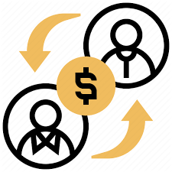
P2P lending markets will be worth between $150 billion and $490 billion by 2020.
MORGAN STANLEY

Slide 6
MAIN PLAYERS
BlockLoan
Fast Invest
Salt
Bitbond
BTCPOP
Kiva

Slide 7

P2P BENEFITS
Lower Fees
Geo-Diversification
No Need for a Bank Account

Slide 8
P2P RISKS
Security
Market Volatility

Slide 9

THE PROBLEM

Slide 10

LENDER
UNIT IN SURPLUS
UNIT IN DEFICIT
UNIT IN SURPLUS
BORROWER
UNIT IN DEFICIT
DIVERGING INTEREST

Slide 11


THE OPPORTUNITY

Slide 12

MATCHING MECHANISM
BORROWER
INVESTOR
INVESTOR

Slide 13

OUR SOLUTION
THE CONTRACT

Slide 14

THE PLATFORM

Slide 15
THE LEDGER
Who lends
Who borrows
The amount
THE INFORMATION GIVEN

Slide 16
THE LEDGER
Public Register
Credit History
A DEMOCRATIC TOOL

Slide 17

ADVANTAGES
Immediate transactions
No Bureaucracy
No transaction fees

